Slide 1

Kronos Kidnapping Incident
Ferguson and Tyler

Slide 2
Scenario Introduction
An unknown number of people associated with the organization GASTech disappeared on 20th January 2014 during a celebration held by the organization.
With limited and disparate data, determine the cause of the disappearance and reconstruct the events that occured.
Notes:
Andy is covering
(30 seconds)

Slide 3
Data Sources
We opted to use the data from project 1 and project 2, using geolocation elements and news sources in tandem to build most complete reconstruction possible.
Data sources:
Map of Kronos
PDF of org chart for GASTech
XLSX of GASTech employee records featuring emails, start dates, military service, etc.
CSV of email headers from two weeks leading up to event.
DOCXs of some employee resumes.
DOCXs of historical reports of events within the Abila.
844 TXT files composed of news articles and public statements in 30 years leading up to the event.
CSV of vehicle assignments by employees.
CSV of credit card transactions by employees.
SHAPE file of Abila.
Notes:
- Duncan

Slide 4
Goals
Provide a clear analysis of the structure of the POK network, with supporting evidence.
Who are the leaders?
Who is part of the extended network?
How has the group structure and organization changed over time?
Where are the potential connections between the POK and GAStech?
Describe the events of January 20–21, 2014. What is the timeline of events?
Provide at least two possible explanations why the GAStech employees may be missing. What evidence do you have to support each of these explanations?
Notes:
-Andy
(1 Minute)

Slide 5

Methods
Given that the project centers around recreation of events, we adopted an approach with a high focus on narrative.
Analysis relied on cleaning and restructuring data, then digging into connections and patterns thereby exposed to fill in the gaps in our understanding and create new avenues for investigation.
Iteratively applying this allowed us to recreate the events and provide the answers and recommendations found in this report.
Tools: Python with NLTK, Neo4j, Tableau
Notes:
Duncan
Every group goes through storming, norming and performing. This can be applied to data.
We looked at all the data. Then took a few different approaches and saw which ones were working best
Data Scrubbing. And data engineering
Dirty data sources that can be used in a variety of ways.
Building re- usable tools
Tableau
Word Searching
Article sentiments
Article timestamping and group for time lines
Article grouping on names for POK structure changes
-

Slide 6

Notes:
Duncan
Got a few leads, but first we have to start out with the POK structures
Methods leads us into question 1

Slide 7
Question 1a & 1c: Structure of PoK
From approximately 1984, GASTech engages in activities with negative results on the local environment of Abila and PoK becomes more active.
Under leadership of Henrick Bodrogi in 1997, PoK engages primarily in protest activities against GASTech for their negative environmental impact.
From 2001 to 2009, Elian Karl leads PoK and group activity becomes more radicalized, vandalism and violent acts during protests mark this period.
Elian Karl goes to jail and later dies in 2009, Silvia Marek takes leadership in approximately 2012 and general radicalization of the group increases.
In 2011, PoK begins engaging in drug activities to fund their operations.
Notes:
-Andy
Changes over time
Who the leaders are
1997
POK: First Leader Henk Borogi (5 Year Disc)
Wife Mira BorogiDies 1997
Joreto Katell, Carmine Osvaldo, Ale Hanne, Jeroen Karel, Valentine Mies, Yanick Cato
Julian Vann dies in addition to Mire Borogi and the group starts to change
They try to get O&G regulations passed in 2000 but the health minister Cesare Nespola Dies.
The health minister is replaced with Vincent Paelou who happened to be the presidents nephew
POK looked at this as government corruption
BY 2001 the founder consider turning over leader ship
Elian Karl becomes president in 2002
2003 New leader changes focus of the group into gov’t corruption and accountability
By 2009 Elian Karel had grown the POK 200-300 People.
Elian Karel goes to jail for tax fraud and dies days before her release (POK takes this offensively
Silvia Mark is now the leader; POK get more violent and protests on the anniversary of Karels death - 2013 Suspects
Hennie Osvaldo → Related to Gas Tech Employee

Slide 8
Question 1b: PoK Extended Network
Valentine Mies – founder of PoK with ties to current employees.
Carmen Osvaldo – founder of PoK with ties to current employees and local government of Abila, facilitated discussions between PoK and government officials.
Isia Vann, an active member of PoK, infiltrates GASTech in 2007 as a perimeter control officer. From this date, Isia begins hiring individuals with ties
Notes:
Duncan
The people that we have connected

Slide 9
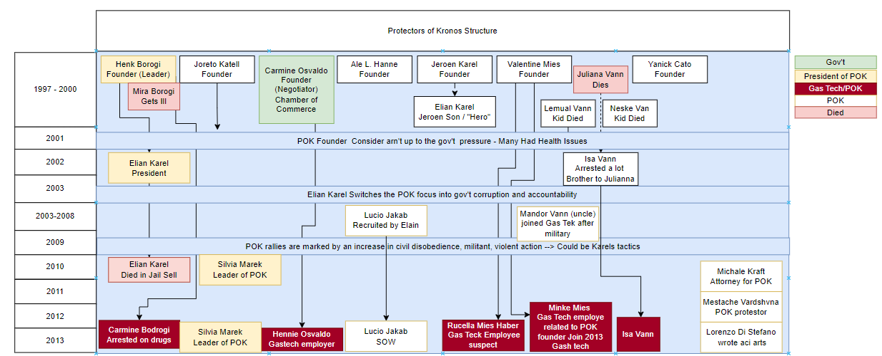
Question 1b: PoK Extended Network
Notes:
Duncan
The people that we have connected

Slide 10
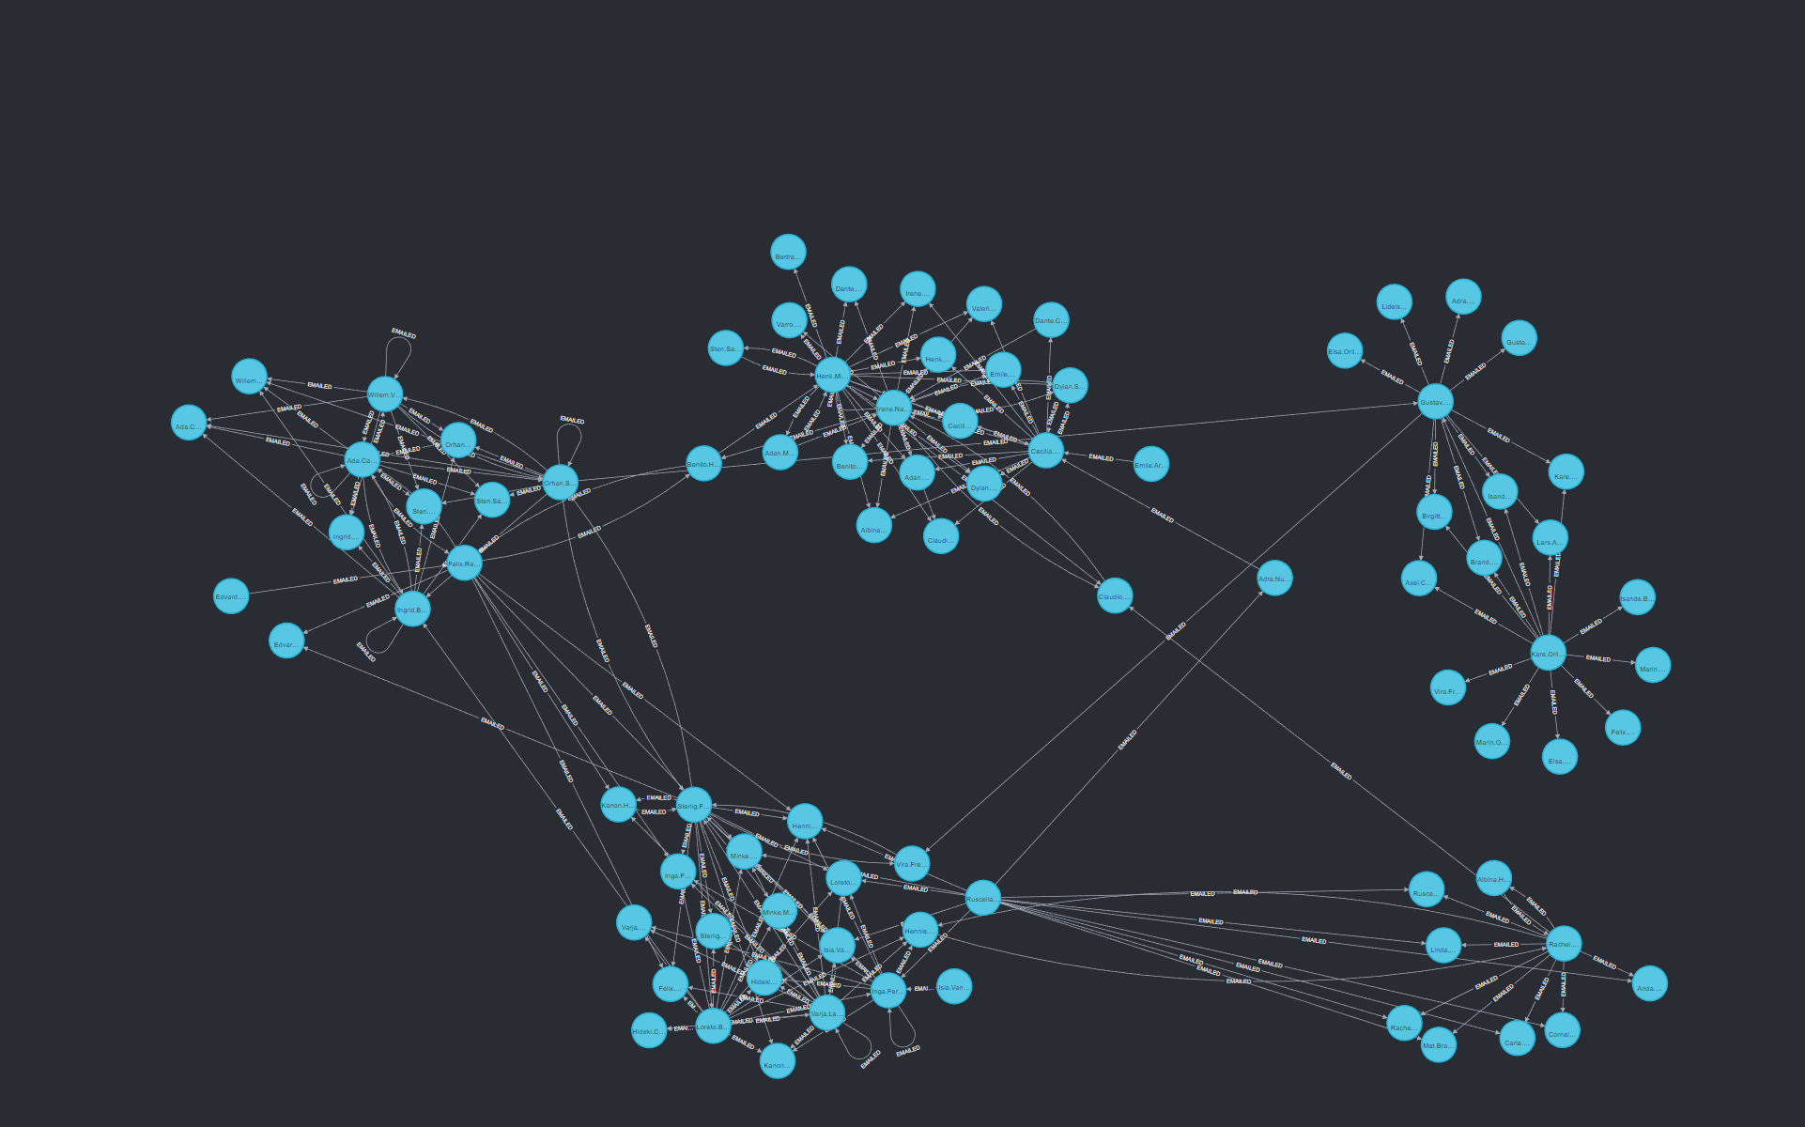
Graph Database
Notes:
Andy

Slide 11
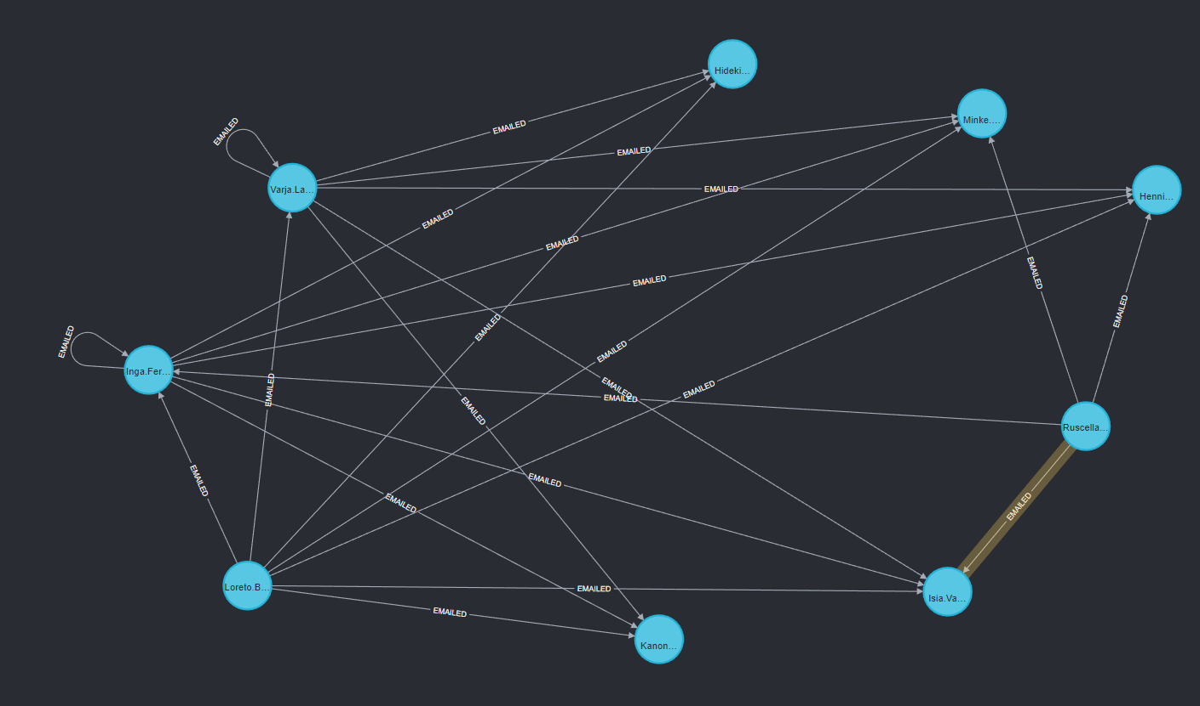
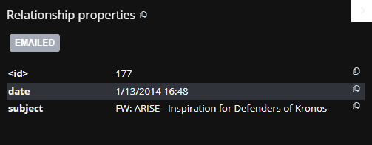
PoK Cluster
Notes:
Andy
Got a few leads, but first we have to start out with the POK structures
Methods leads us into question 1

Slide 12
Question 1d: PoK/GasTech Employees
Isia Vann is an employee of GASTech and confirmed member of PoK.
Loreto Bodrogi is and employee of GASTech and related to Carmine Bodrogi – an active member of PoK. Their father Henrick Bodrogi is a founding member of PoK, and their mother Mira Bodrogi died of health issues likely related to GASTech’s environmental negligence.
Ruscella Mies-Haber and Minke Mies are both current employees of GASTech and appear to be related to Valentine Mies, a founding member of Pok.
Hennie Osvaldo is a current employee of GASTech. His sister Carmen is an active member of PoK.
Notes:
-- Andy

Slide 13
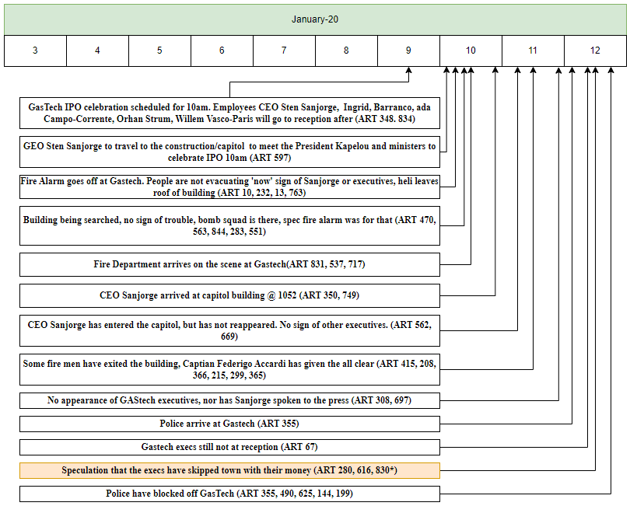
Question 2: Jan 20-21st Event Timeline
Notes:
- Duncan
The way in which we established a base time line was to strip the dates off of the articles. There was then a trend that we noticed in the times being offered.
I went through and group by the hour for the articles. This took the file from something like 845-> 285 in the dates that we want then in to 105. I then did a word analysis on this but figured it would be best to just read these articles and put up a timeline. I then used different words that I saw with in these articles to go through search for articles that had these words in them.

Slide 14
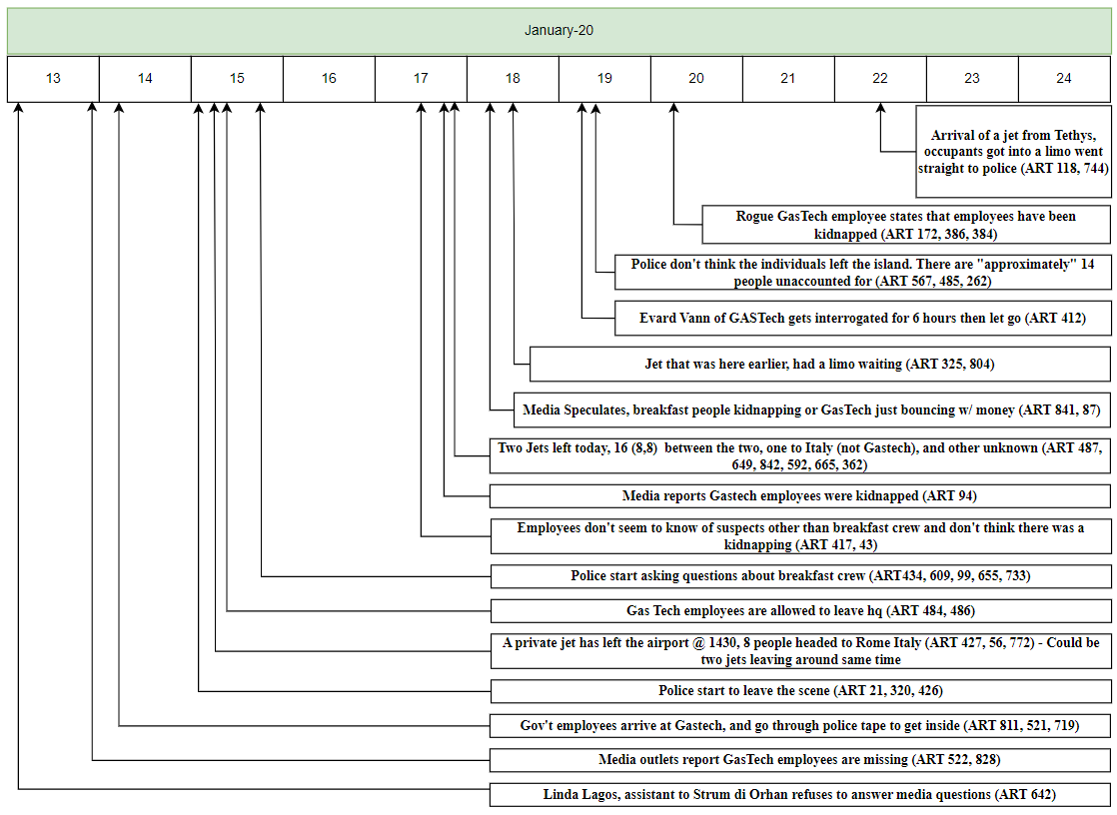
Question 2: Jan 20-21st Event Timeline
Notes:
- Duncan

Slide 15
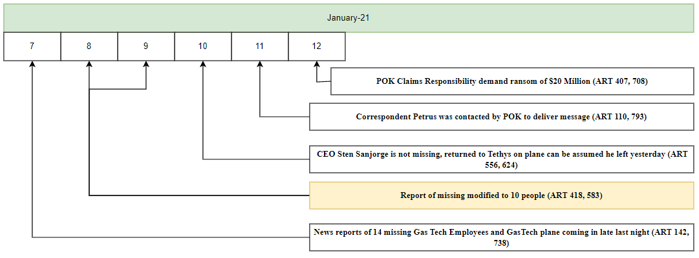
Question 2: Jan 20-21st Event Timeline
Notes:
- Duncan

Slide 16
Question 3: Scenario Hypothesis I
PoK wants to embarrass and expose some activity that the executives were engaged in.
Articles state that the executives were missing during the celebration and subsequent bomb threat but were later accounted for when they turned up at the police station the night of January 20th.
PoK claimed responsibility for kidnapping them, but the executives were never actually kidnapped.
If PoK had insider knowledge that the executives would not be attending the celebration and were engaged in an activity that could be damaging to the executives, GASTech, or associated parties, then claiming responsibility for kidnapping them would expose their absence and limit their pool of alibis related to their whereabouts.
Notes:
Andy
The news articles cite that I might be the GAS Tech people skipping town with their money.
There is a lot of speculation placed by the reporters that need to be sifted through
They also stated that maybe it was the breakfast people that were kidnappers
In my opinion, the Gas tech employees that had relations to the POK are the ones that pretended to get kidnapped. The other gas tech employee interviews doesn’t really state that there were villians. They can only state the breakfast crew. They did it during a time when they knew the execs were going on a trip to make it look like they skipped town. Additionally Article 386. AN unconfirmed gas tech person is the one who stated that the people were kidnapped. Until then they were just unaccounted for in the police reports.
There were lots of different false words that were through out the different articles such as ‘robs you’ or the name of the dead girl. Also going into names of the dead founder… But when you actually start looking at a few or the articles you knotice that there is a smooth trend. There ar about 4 or 5 articles for a day, they are clustered by the months. They give you sorta the same information. Mostly that during the 1984 that gastech was essentially polluting and getting government kick backs. This lead s to a few deaths and POK goes from some what peace full to become more and more violent.

Slide 17
Question 3: Scenario Hypothesis II
PoK did successfully perform the kidnapping, but the ransom demand was met by the executives.
In multiple public letters PoK claims responsibility for the disappearance of the executives and demands a $20M ransom for their release.
It is possible that the using the IPO money recently secured by GASTech, the executives paid the ransom themselves and were released by the kidnappers.
If the ransom was paid, then the executives may avoid some scrutiny for their activities and the goal of inflicting financial damage to GASTech, as well as securing significant funding for future endeavors, has been met by PoK.
Notes:
- Duncan

Slide 18
Conclusion
There’s been growing animosity between PoK and GasTech for about 30 years.
During this time, it appears that PoK has infiltrated GasTech as employees.
The true events of January 20th and 21st are likely unable to be directly recreated without interviewing the PoK GasTech employees identified and the executive officers of GasTech to a higher degree.
Questions?
Notes:
- Andy

